Slide 1
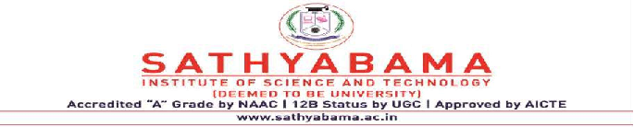
ROBOTIC PROCESS AUTOMATION
Project Supervisor: Dr. L.K.Joshila grace,
Name of the Student: Mr. Subhash raavi
Register Number: 39110819

Slide 2
Presentation Outline
Course Certificate
Introduction
Objectives
System Architecture / Ideation Map
Module Implementation
Application Snapshots
Results and Discussions
Conclusion & Future work
References

Slide 3
Course Certificate

Slide 4
Introduction
Robotic process automation (RPA) is a software technology that makes it easy to build, deploy, and manage software robots that emulate humans actions interacting with digital systems and software. Just like people, software robots can do things like understand what’s on a screen, complete the right keystrokes, navigate systems, identify and extract data, and perform a wide range of defined actions.
To create a bot that automaticallysend emails with attachments to a list of people
Objective:
The main objective behind this is to get familiar with MS EXCEL VBO and emails with attachment to bunch of people

Slide 5


Slide 6
OBJECTIVES
Gain insights into building blocks of blue prism automation.
Importing MS Excel VBO (Visual Basic for Applications) in Blue Prism.
Importing Email VBO (Visual Basic for Applications) in Blue Prism.
Tuning Process Studio with specific needs.
Working with different stages in the Process studio.
Building a bot to automatically send mails with attachments to a list of people.
Scope of RPA:
RPA has provided an excellent solution for organizations repetitive,mundane,rule –based processes with software bots
It is now helping organizations who were looking to increase

Slide 7
workflow accuracy and in the IT sector
To accomplish this:
Configure the process model:
Import MS Excel VBO
Import Email VBO
Process Model binding with MS Excel VBO
Process Model binding with Email VBO
Adding Process Stages: Create Instance Open Excel file Getting email IDs Configuring Email Fetching attachments Sending mails
Test the model
Test Process Model

Slide 8
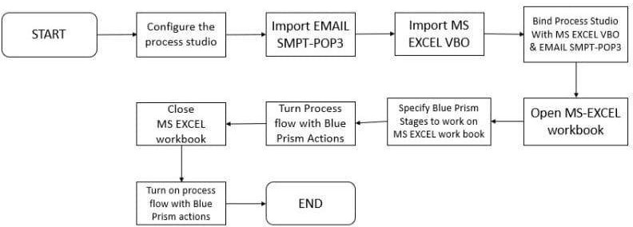
System Architecture / Ideation Map

Slide 9
Project Implementation
Hardware and Software Requirements:
The following is the Hardware required to complete this project:
Internet connection to download and activate
Administration access to install and run Blue Prism
Minimum 10GB free disk space
Windows 8.1 or 10 (64-bit version only) OR Cloud: Get started free, *Cloud account required
Minimum System Requirements To run Office Excel 2013, your computer needs to meet the following minimum hardware requirements:
500 megahertz (MHz)

Slide 10
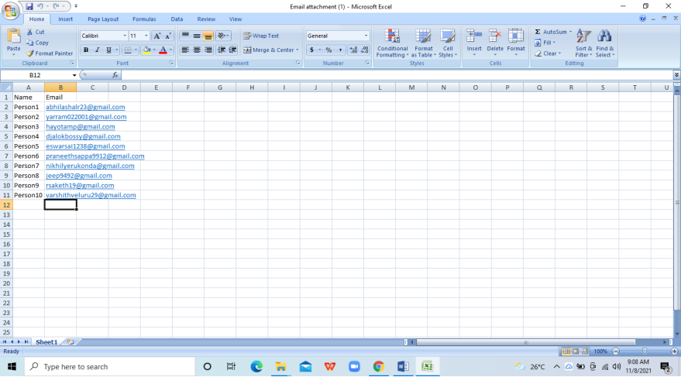
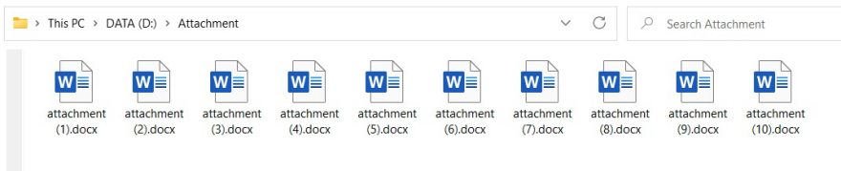
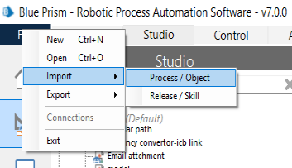
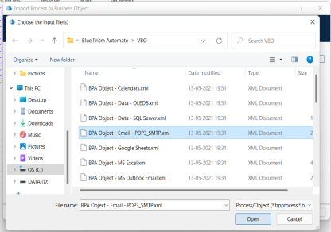
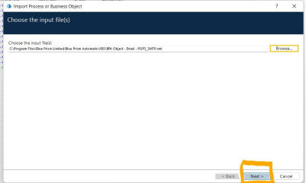
Construction:
Activity 1:
Step 1:First store the name and email address of the people in Excel and Store the attachment to add in email in a folder
Step 2: Import EMAIL POP3/SMTP
Click on file->Then on import->then Process/Object->Browse-> (C:\Program Files\Blue Prism Limited\Blue Prism
Automate\VBO\BPA Object – Email- POP3_SMTP.xml) ->click Next->Then Finish.

Slide 11
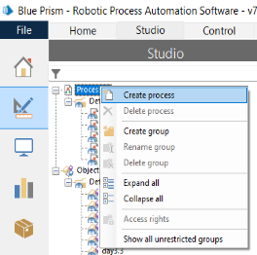
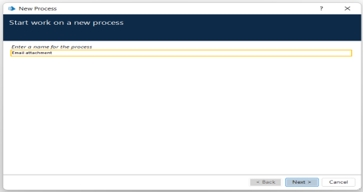
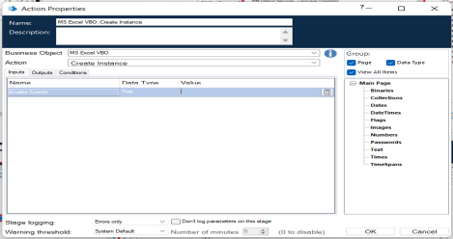
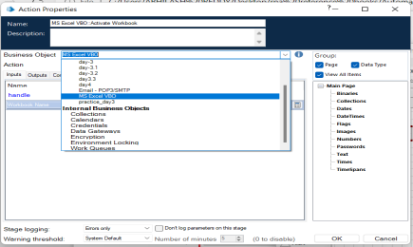
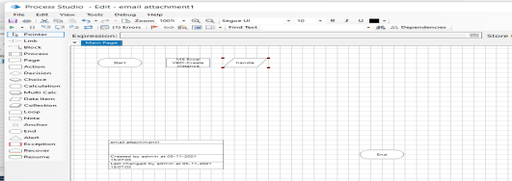
Activity 2:
Step 1: create a process
After launching the Blue Prism, Open Studio tab, right-click on process,
and select Create process.Give the name as Email attachment then click
next and then finish.
creating process.
The screenshots clearly explain the process of
Step 2:
Create an action stage, select MS Excel VBO from Business object drop down, select Create instance action. Create Data Item as follows, • type = number, • name =” handle”.

Slide 12
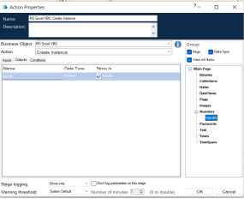
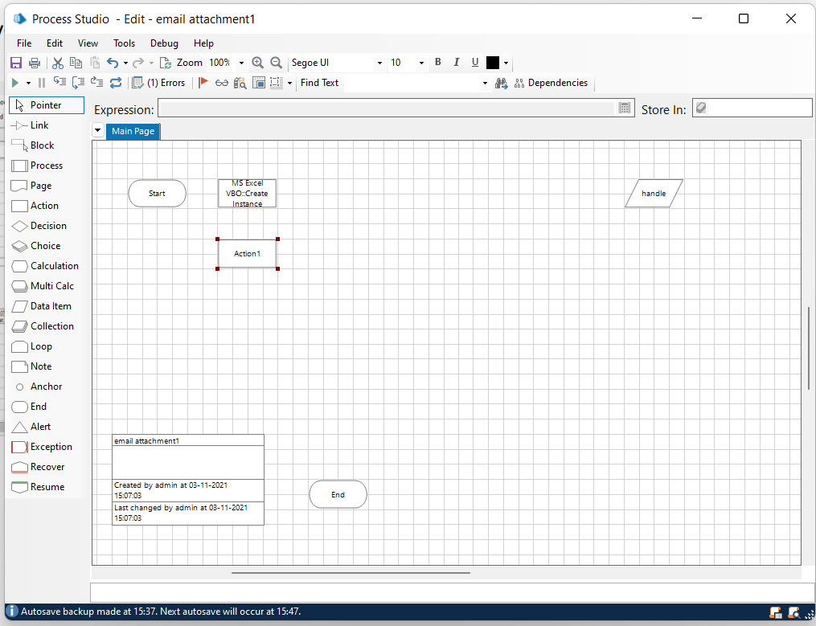
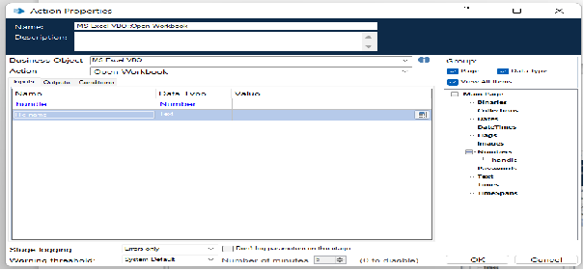
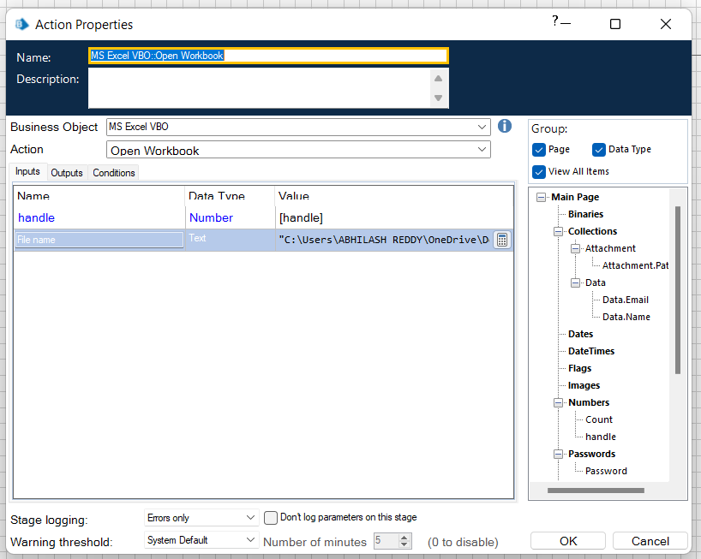
Go to output tab and drag handle into Store In column, click on ok.
Step 3:
Create an action stage, select MS Excel VBO from Business object drop down, select Open Workbook action.
In the input tab give the handle and path of the excel file

Slide 13
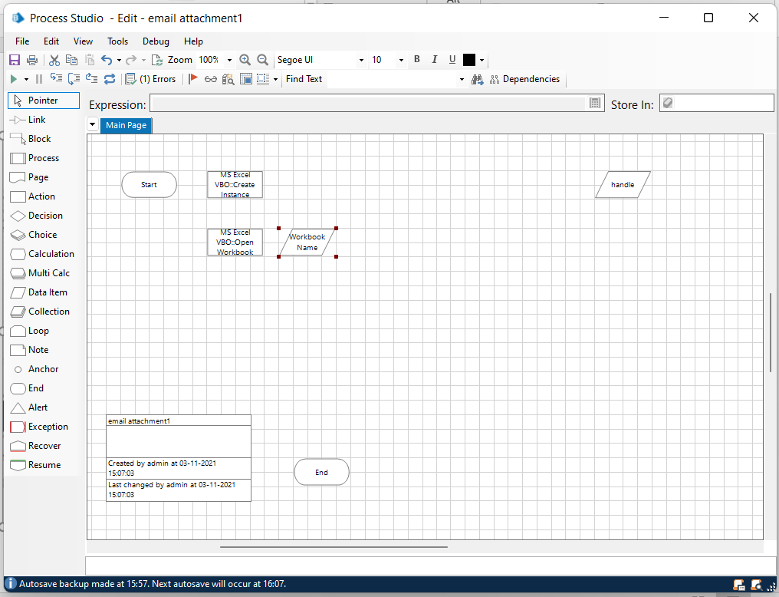
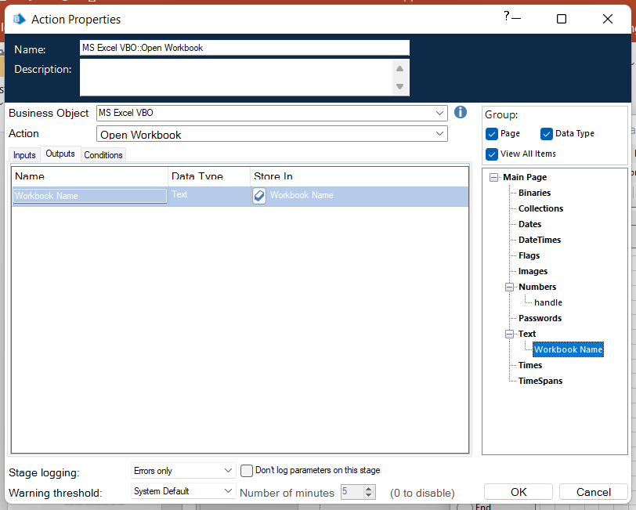
Create Data Item as follows, • type = text; name =” Workbook
name”
Go to output tab and drag Workbook name into Store in column, click on ok.

Slide 14
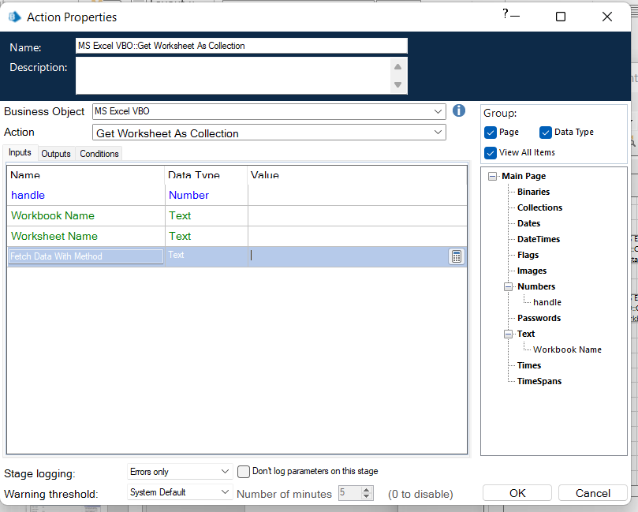
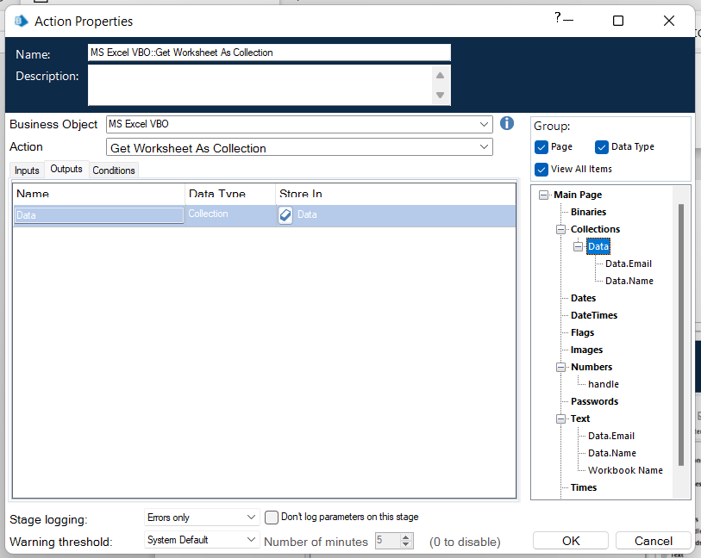
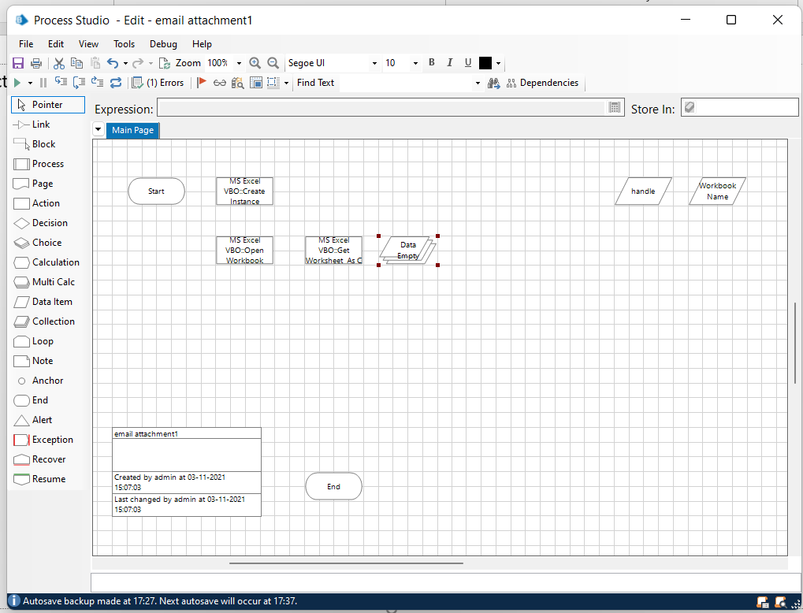
Step 4:
Create an action stage, select MS Excel VBO from Business object drop down, select Get worksheet as collection.
In the input tab give the handle, workbook name .
Create Collection,and click on add with fields as follows, • type = text; name =” Name” • type = text; name= “Email”.
Go to output tab and drag Data into Store in
column, click on ok.

Slide 15
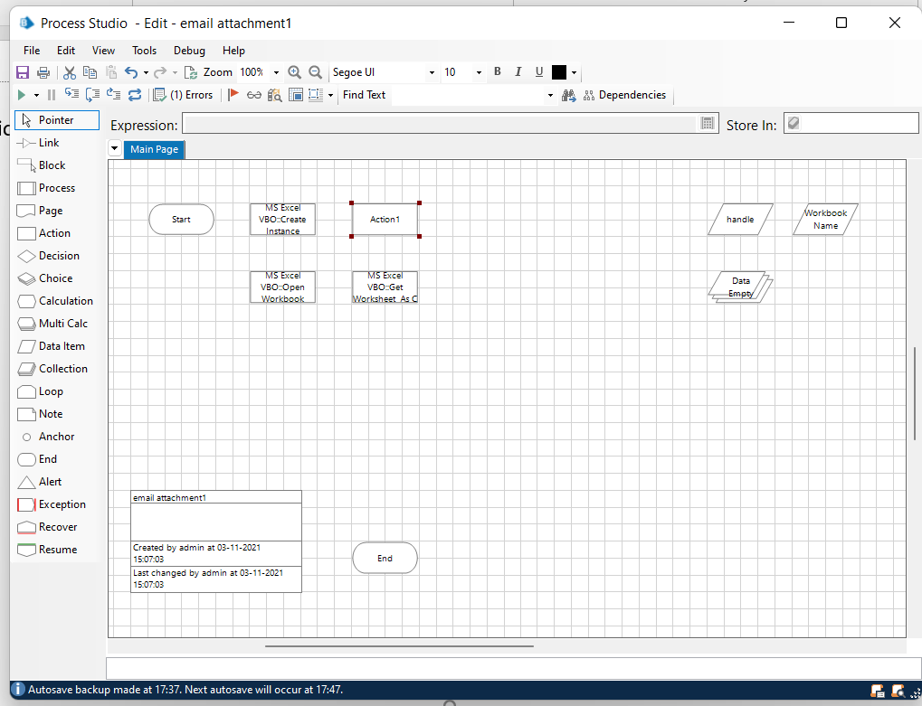
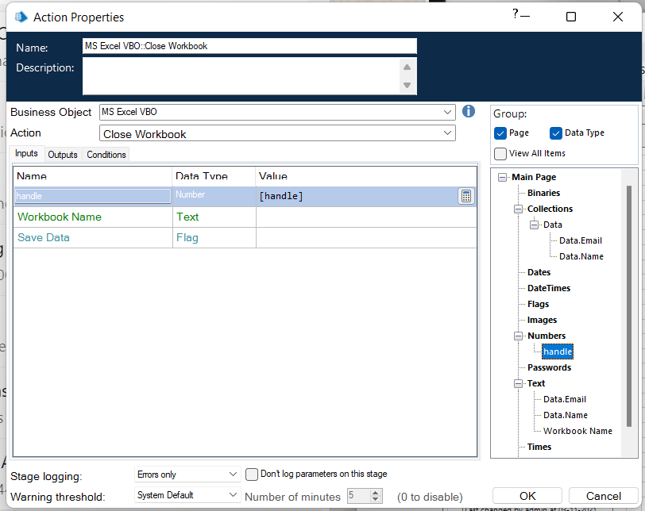
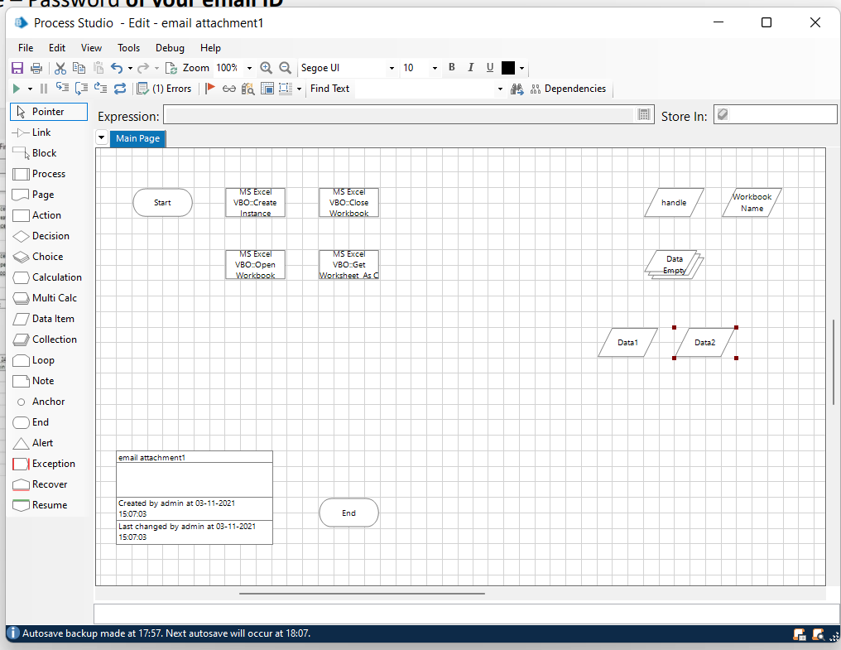
Step 5:
Create an action stage, select MS Excel VBO from Business object drop down, select Close Instance action.
Drag and drop the handle, click on ok.
Step 6:
Add two data items one for Email and other for Password.
To store the Email
• Name – Email
• Type – Text
• Initial value – Your email ID
2. To store the Password
• Name - Password
• Type – Password
• Initial value – Password of your email ID

Slide 16
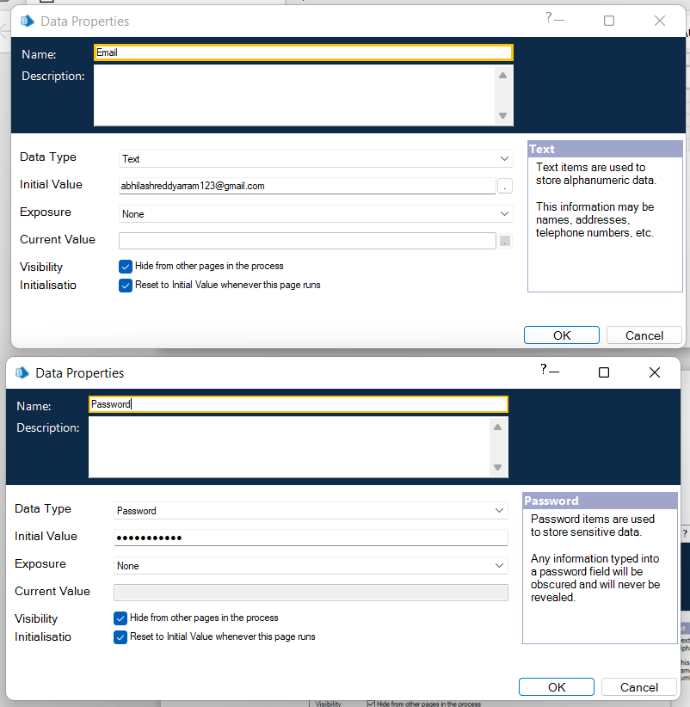
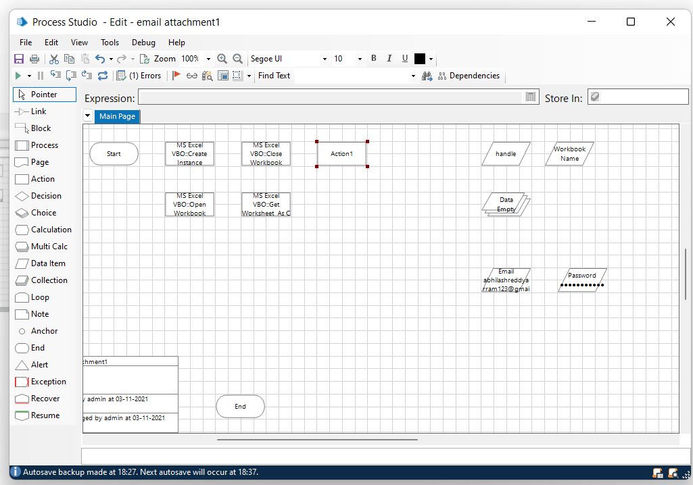
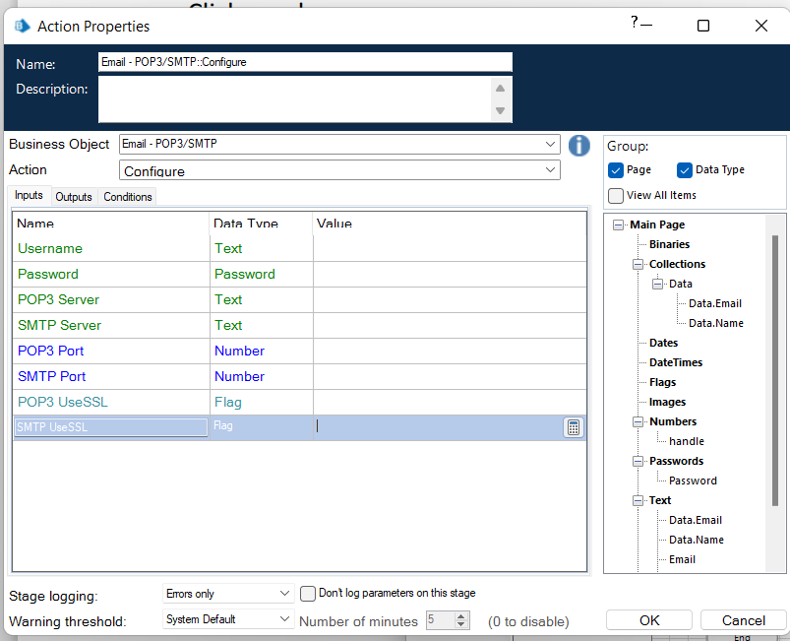
Step 7:
Create an action stage, select Email VBO from Business object drop down, select Configure action.

Slide 17
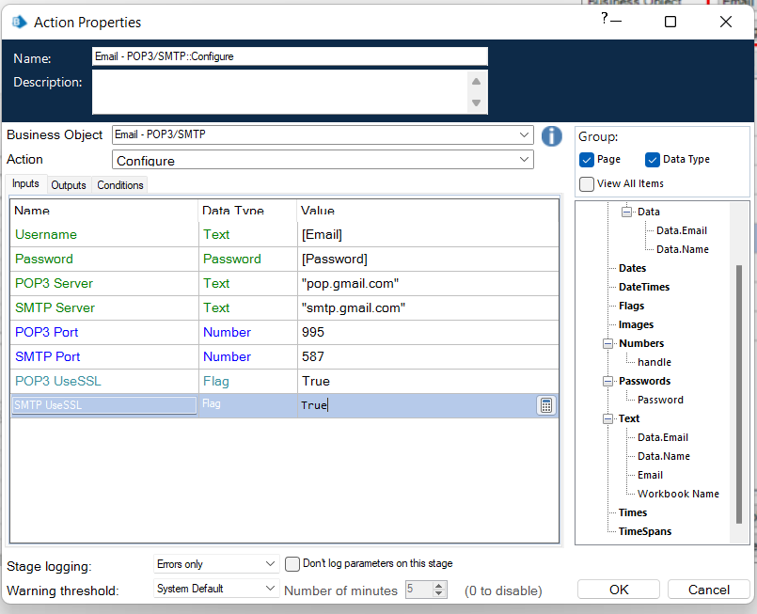
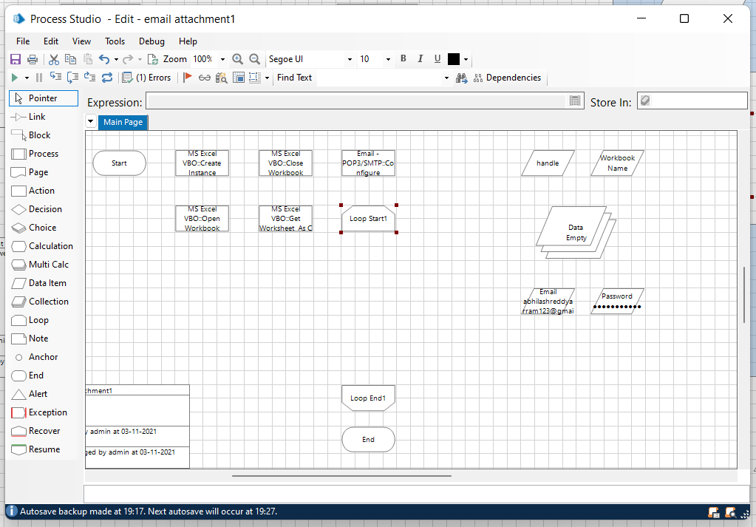
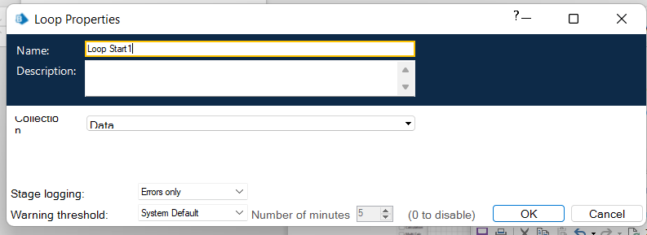
In the input tab drag the Email and Password and the give the following details:
• POP3 Server = "pop.gmail.com"
• SMTP Server = "smtp.gmail.com"
• POP3 Port = 995
• SMTP Port = 587
• POP3 UseSSL = True
• SMTP UseSSL = True
Step 8:Add a loop stage and make it to loop for Data collection.
Drag and drop a loop stage and change the arrangement of all the stages in the page, double click on it and in the collection drop down select data collection and click ok.

Slide 18
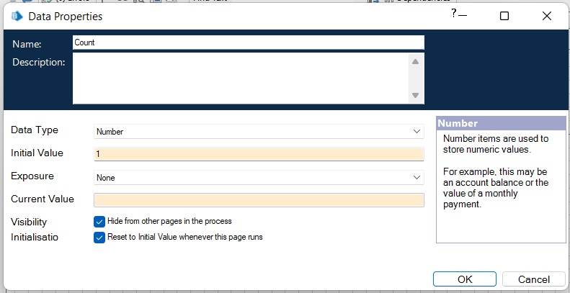
Step 9:Add two data items
Data item 1
To store the number to increment the path for each attachment
• Name – Count
• Type – Number
• Initial value – 1
Second data item
To store the path of the attachment (only the constant path. For the numerical part we will be using calculation stage.
• Name – Path
• Type – Text
• Initial value – constant values in the attachment path.

Slide 19
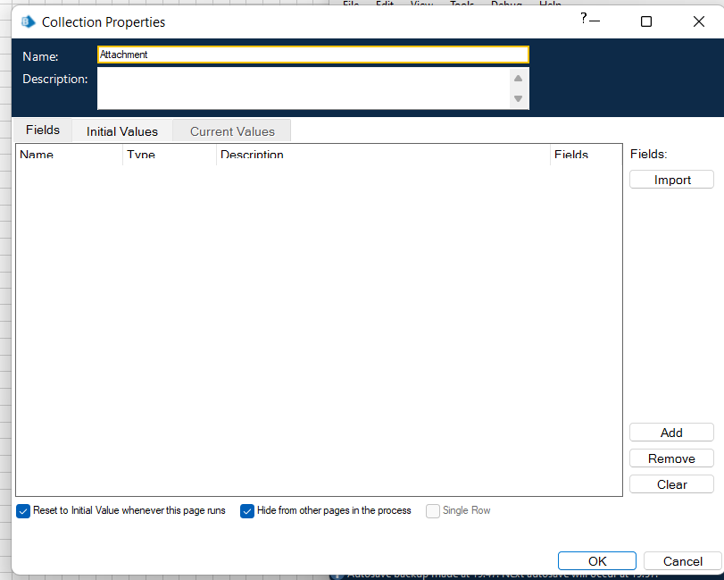
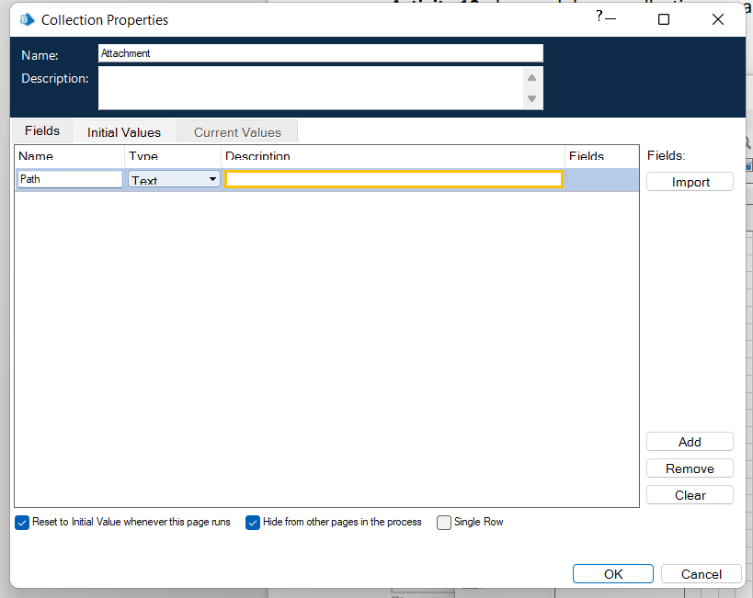
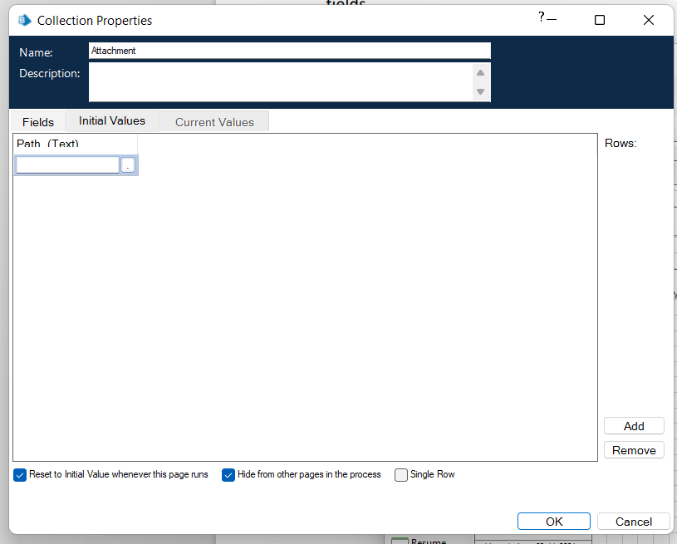
Step 10:drag and drop a collection, rename it as Attachment
give the following as initial fields
Name – Path;
type – Text
Create a row in initial values column.

Slide 20
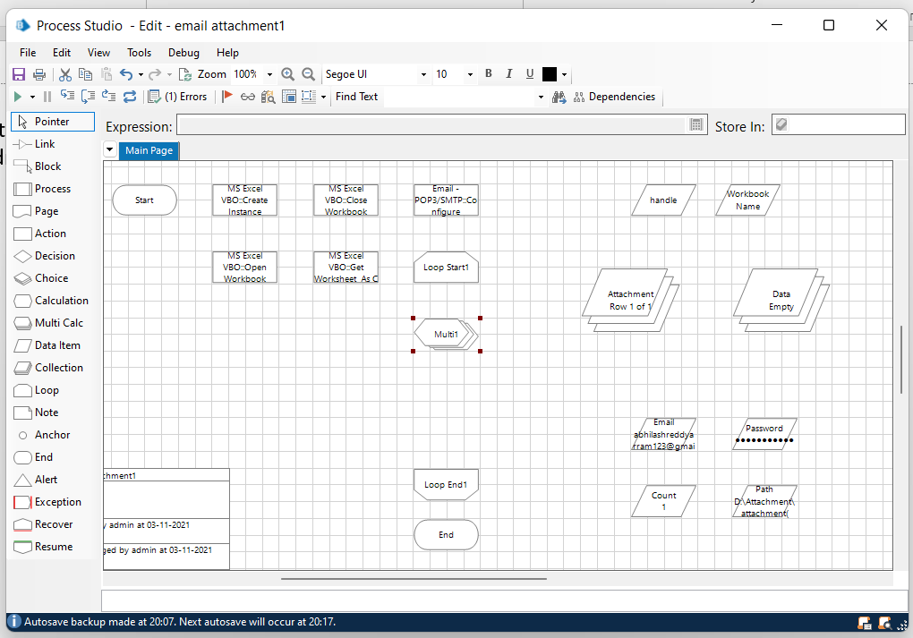
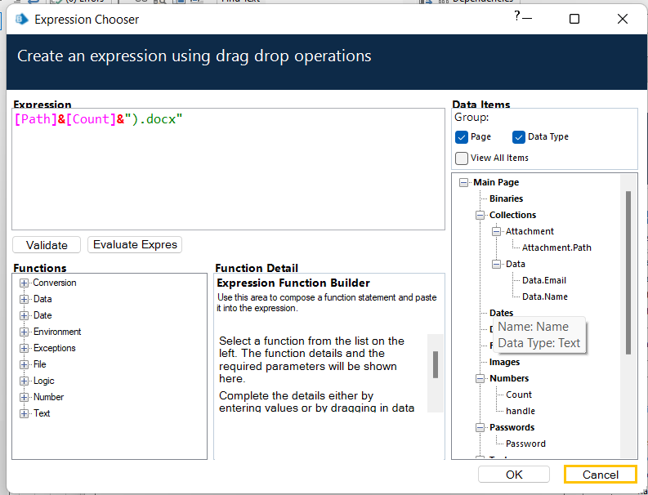
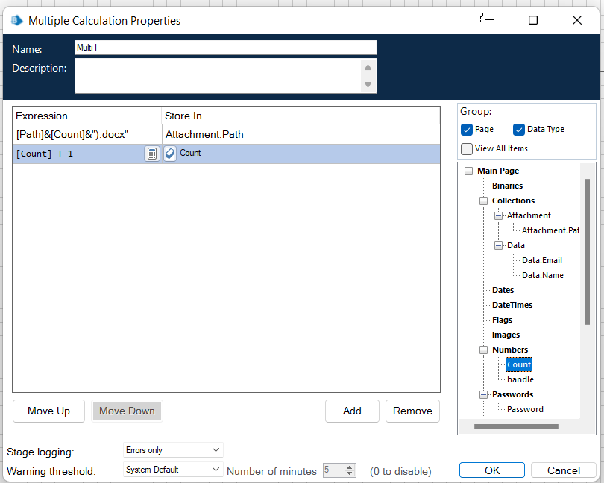
Step 11:
Add a multi calculation stage to store the path to Attachment collection and to calculate path. Drag and drop a multi calculation stage
double click on it and add the following:
Calculate the path and store it in Attachment collection.
increment count.

Slide 21
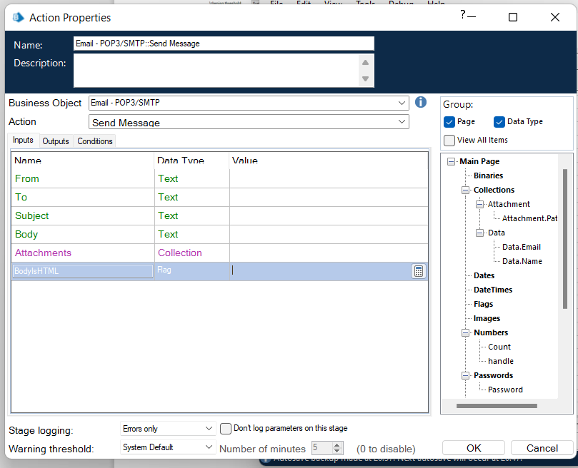
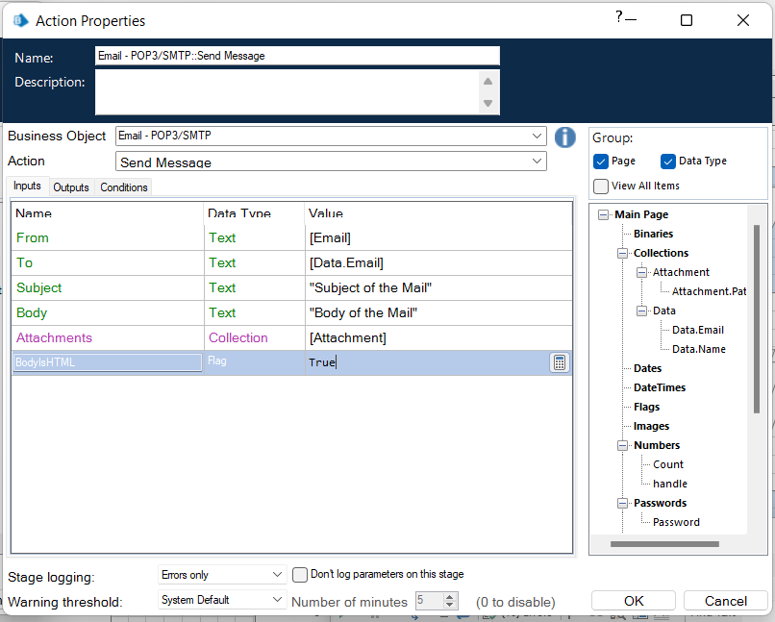
Step 12:Create an action stage, select Email SMTP from Business object drop down, select Send message action.
In the input tab give the following details:
• From = Email data item
• To = Email from data collection
• Subject = The subject you want to send
• Body = The body you want to send
• Attachment = Attachment collection
Click on ok

Slide 22
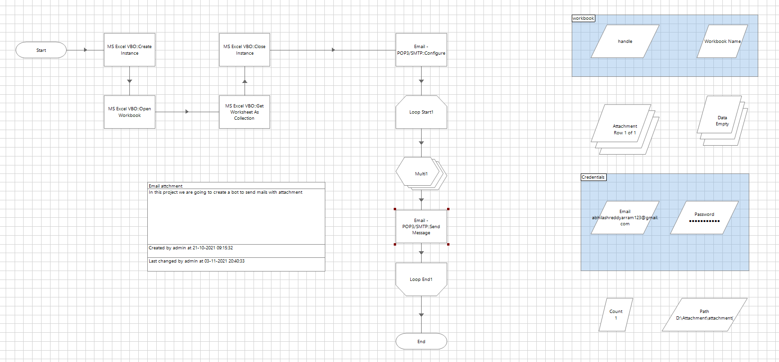
Step 13:
Link all the stages and run the bot at different timings to notice getting login to different classes. Do Proper connections (Links).

Slide 23
Measurement and Analysis:
1)cost effective
2)Accuracy&quality
3)consistency
4)improved analytics
5)increased employee productivity
6)increased customer satisfaction
7)faster
8)reconcilication from multiple systems
9)versatility
10)better IT support
• Interpretation of Results:
Email automation is a powerful marketing automation tool that lets you send the right message to the right people at the right time.
Can produce the accurate results without any deviation in terms of quality it gives the perfect output.

Slide 24


Slide 25
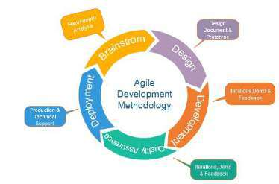
Methodology
Agile methodology is a practice which promotes continues interaction of development and testing during the SDLC process of any project. In the Agile method, the entire project is divided into small incremental builds. Through this project, we can create a system that will automatically sends the certificates to candidates through email with a particular subject line andbody of email

Slide 26
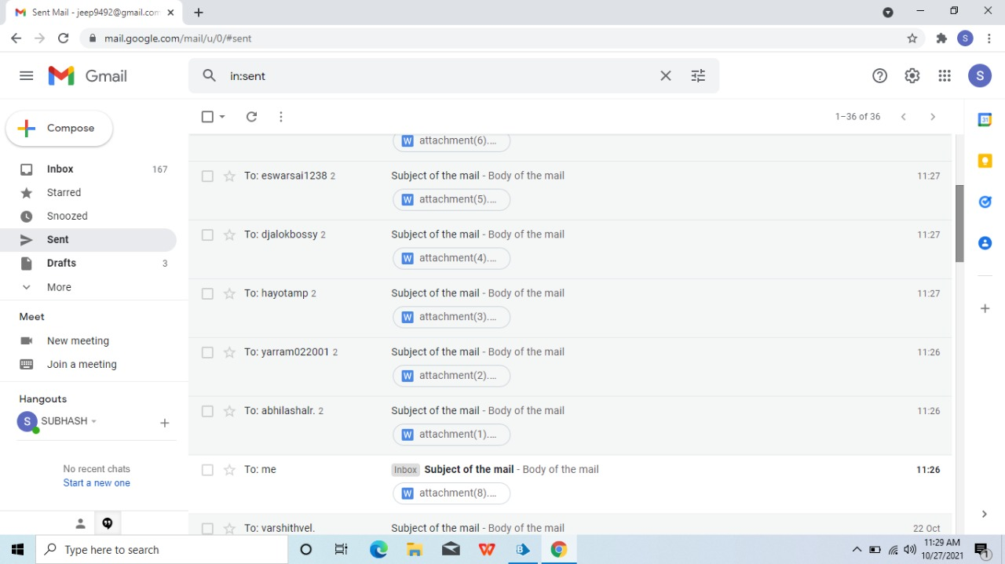
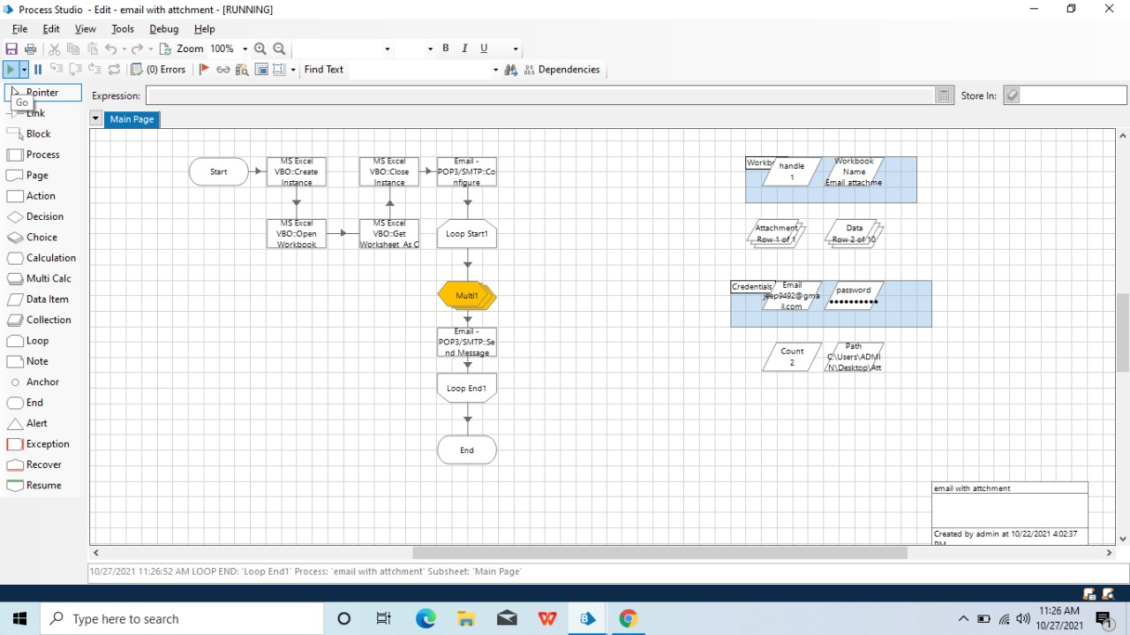
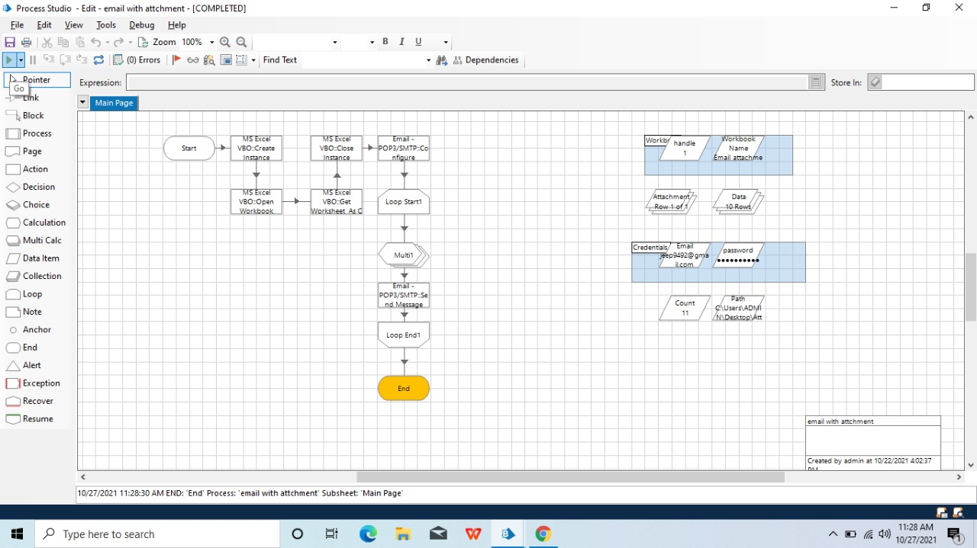
Results and Discussion

Slide 27
Conclusion
On doing this project we got to know that email automation is very important for our further
Development . At first we have to store the each person email id in Microsoft Excel and save it for later
use.Then we have to import MS-EXCEL VBO and Email SMTP-POP3 VOB into the Blue Prism , then create
the process and then we have to give the following actions such as create instance , opening excel file ,
getting email id's , closing the excel file , Configuring Email,fetching the attachments and then sending
the mails. Click on refresh button then click run button to run the program.Then the resultant output
will be emails sent with the attachment.
With a a few chats of our group members the overall planning and research regarding our
project went well.We all tried our best and included the necessary points required regarding our topic.
Future scope:
In future many developments will take place in this email automation.This tecnique will become a lot more useful to develop the
email marketing. Almost 80-90% population use this top jen tool

Slide 28
References
[1] M. Lacity, L. P. Willcocks, & A.Craig.Robotic process automation at Telefonica O2.The Outsourcing Unit Working Research
Paper Series, 2015
[2] IRPA, “Introduction To Robotic Process Automation,” tech. rep., 2015.
[3] H. P. Fung "Criteria, use cases and effects of information technology process automation (ITPA)." Advances in Robotics &
Automation 3 (2014).
[4] Dana Nau, Malik Ghallab, and Paolo Traverso Automated Planning: Theory & Practice. Morgan Kaufmann, 2014.
[5] M. Barrett, E. Oborn, W. J. Orlikowski, and J. Yates, “Reconfiguring 4Relations: Robotic Innovations in Pharmacy Work ,”
Organ. Sci., vol. 23, pp. 1448– 1466, 2012.

